Slide 1
FIRST TERM BEGINS
REVISION
NUMBER BASE & CLASSIFICATION OF COMPUTERS

Slide 2
WEEK 2
Internet Search Engine & Browser
Internet Search Engine are web applications that helps in searching for information on the world wide web. Examples are Google.com, Wikipedia, Mamma.com, Youtube.com, Ask.com e.t.c

Slide 3
Browser
A Browser is an application that allows us to search and get information on the World wide web. It majorly allows us to surf the www easily and download materials.
Examples of Browsers are Microsoft Edge, Google Chrome, Mozilla fire fox, Opera-mini, Safari browser, Netscape navigator, UC browser, Phoenix browsere.t.c.

Slide 4


Pictures of common browsers

Slide 5
Benefits/Uses of Internet
The Internet is used to communicate with friends.
It is used in searching for Information
E-Banking: transactions can be easily done online.
E-entertainment: Music & videos can be downloaded online.
it is used in planning in e-commerce(Buying & selling online)
It is used in Education (Online school & Educational materials).

Slide 6
Abuses of the Internet
Fraud: People use internet to scam people.
Piracy of software: Illegal duplication of software without owner’s permission.
Pornography: Sites that show pictures of naked people.
Hacking: People use internet to gain access to one’s computer without permission.
Pliagiarism: Stealing other people ittectual property

Slide 7
Class Task
Convert 100₂ to base 10
Convert 100₁₀ to base 2

Slide 8
Evaluation test
Compare a Browser and a Search Engine
What is a Browser?
List ten examples of a browser

Slide 9
WEEK 3: Digital divide
Digital divide describes the fact that the world can be divided into two(2), people who do & people who don’t have access to Modern ICT gadgets.

Slide 10
Classes of people where Digital Divide exists.
Between the rich and the poor
Between Males & Females
People in the rural areas & Urban areas
Between Developed and Developing Countries

Slide 11
Features of Old Economy These is the economy mainly based on subsistence farming
Intense labour based production.
Mechanical ways of production.
Poor Economic Earning
Restriction in Time & Space

Slide 12
FEATURES OF NEW ECONOMY
Technology driven.
Knowledge based
Time , space & distance are irrelevant.

Slide 13
WEEK 4: DIGITAL LITERACY
Digital literacy encompasses the skills required to use technology safely, effectively and responsibly.
As technology continues to become more and more ingrained in daily life, the importance of learning digital literacy skills is becoming increasingly apparent.

Slide 14
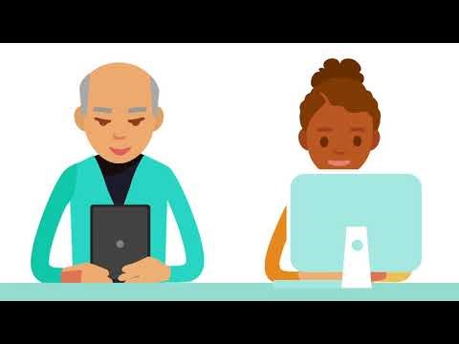

Slide 15
DIGITAL LITERACY IN EDUCATION
It Supports Educational Progress: Students with digital literacy skills will be more comfortable and confident in these learning platforms.
Increase Online Safety: Digital Literacy can empower students with important knowledge, tools and resources to protect their safety and privacy.

Slide 16
Improve Digital Equity: it helps to bridge the digital divide, among underrepresented groups, helping to upskill these students so they may have increased career opportunities in the future.
DIGITAL LITERACY IN WORKFORCE
it allows staff to connect with each other and thus strengthen teamwork.
It expands digital competency and encourage knowledge sharing practices
Investing in new technologies is important and helps in training staff.

Slide 17
DIGITAL LITERACY IN THE SOCIETY
It helps to communicate information through typing on various digital platforms.
Helps in making connection with friends, family, colleagues in far distances.
It save money and time by getting simple daily tasks like shopping, banking done easily.

Slide 18
CLASS TASK
Define Digital Literacy
List three (3) benefits of digital literacy in the society.
State three (3) skills that can be learnt in this digital world.

Slide 19
DATABASE
Database is a defined collection of data and records stored on a computer for future purpose.

Slide 20
FORMS OF DATABASE

Slide 21
Assignment
Define a virus
State the types of Virus
Define the following i) Digital divide ii) Cell
State three (3) features of New Economy.

Slide 22
SPREADSHEET
A Spreadsheet is an application used to carry out mathematical and statistical analysis.
Examples Ms Excel, Vp planner, Ms planner, Lotus 1-2-3, Apple i-note, Google sheet, Super calc e.t.c
Basic terms in Spreadsheet.
Cell: it is the intersection of a Row & a column.
Column: it is the vertical section of a spreadsheet.
Row: it is the horizontal section of a spreadsheet.
Range: It’s a set of numbers that indicate a start point & an end point.

Slide 23
Cell referencing: This is the use of alphanumeric value to identify a cell in a worksheet or another worksheet.
Function: This is a pre-defined formula used to carry out basic calculations using specific values in a particular order.
Worksheet: It is the area on a spreadsheet where all calculations are carried out.
Workbook: This is a collection of several worksheets in a spreadsheet.

Slide 24
How to create an Excel workbook
Click windows button
Type Excel in the search bar
Click Enter
How to Launch an Excel workbook
Click on document
Navigate to your document
Double click the Excel document.

Slide 25
How to save an Excel workbook
On the document, click File
Click Save As
Type in your desired document name
OR
Click shortcut key CTRL + S

Slide 26
Assignment
Define Database
State two (2) uses of a database.
State five uses of Internet
State five abuses of Internet.

Slide 27
Uses of Spreadsheet
Its is used in preparing budget
It is used in making Invoices
It is used in Banking activities
It is used in preparing payroll
It is used in Business to calculate daily transactions.
It is used in carrying out Engineering calculations.

Slide 29
Units of storage in Computers
The units of storage are the various means of representing & measuring data or information in the computer.
The common storage unit terminologies are
Bit: It’s the smallest unit of storage. Its either “0” or “1”.
Nibble: It’s a term for four-bit aggregation. ie 4 bits
Byte: It’s a unit of storage consisting of 8bits.
Character: This a letter(a ,b …) or a number
Word: A word consists of 2 Bytes.
Kilobyte: A unit of storage consisting of 1024 bytes
Megabyte: A unit of storage consisting of 1024 kilobytes
Gigabyte: A unit of storage consisting of 1024 Megabytes
Terabyte: A unit of storage consisting of 1024 Gigabytes
Petabyte: A unit of storage consisting of 1024 Teraqbytes

Slide 30
Conversion from one unit to another
Ex 1: Convert 50KB to Megabyte.
Solu
1024KB=1MB
Therefore 50KB = 50/1024 * 1 = 0.0488MB or 0.05MB
Ex 2: Convert 0.15MB to kilobyte
Solu
1MB= 1024KB
Therefore 0.15MB = 0.15/1 * 1024 = 153.6KB

Slide 31
Ex 3: Convert 0.00005GB to kilobyte
Solu
1GB = 1024*1024 KB
Therefore 0.00005 GB = 0.00005/1 * (1024* 1024);
0.00005 * 1048576 = 52.428 or 52.4 KB
Ex 4: Convert 0.17 TB = megabyte (MB)
Solu
1 TB = 1024 * 1024 MB
Therefore 0.17 TB = 0.17* (1024 * 1024)
= 178257.92

Slide 32
Class Exercise
1. Which of the following is the smallest unit of storage?
Byte B) Bit C) Kilobyte D) Megabyte
2. Which of the following is the largest unit of storage?
A) Byte B) Bit C) Terabyte D) Megabyte
3. 1024 Megabytes is equal to
A)Byte B) Bit C) Kilobyte D) Megabyte
4. The unit of measurement in 4bits is
A) Nibble B) Byte C) Kilobyte D) Megabyte
5. 8bits is equal to
A) Byte B) Bit C) Kilobyte D) Megabyte

Slide 33
Assignment
1. Convert 0.0003 PB to Gigabyte
2. Define the units of Storage in the Computer
3. A number in base 16 is called ___
4. A number in base 8 is called ____

Slide 34
VIRUS
A virus is a malware designed by perpetrators that enters into the computer, replicates itself & cause damage to the computer.
Types of Virus
Boot Sector
Executable file virus
Attack on Document

Slide 35
Sources of Virus
Infected file
Infected diskette
Internet downloads
Email attachment
Infected Flash drive
Virus detection programs
Avast
Mc afee
AVG
Norton
Kapersky

Slide 36
Computer Professionals & Computer Professional Bodies, Virus
Computer Professionals are experts who use computer to carry out their day to day tasks.
Some Computer Professionals
Computer Manager: They are the overall head of the computer department.
Computer Programmer: They develop softwares with the use of various programming languages.
Computer Engineer: They design & build hardware parts.
System Analyst: They review details of existing system & implements new system.
Computer Technician: They repair & fix computer parts.
Computer Educator: They teach Computer across different levels.

Slide 37
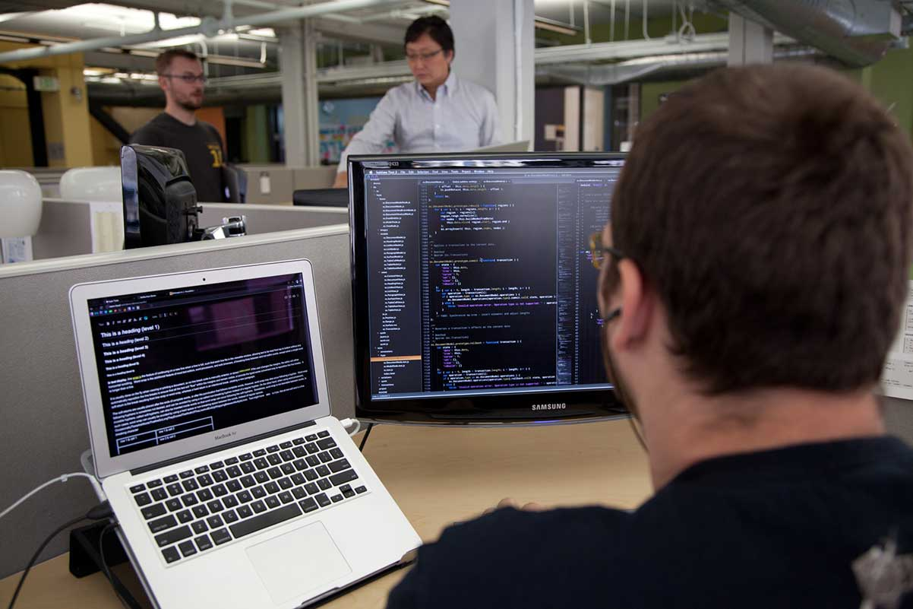
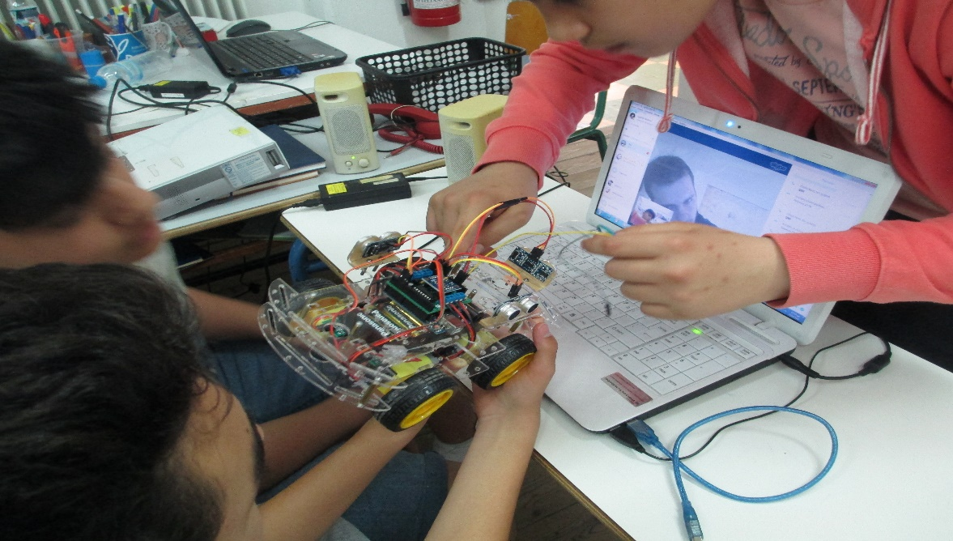



Slide 38
Computer Professional Bodies
Nigeria Computer Society (NCS): They are the overall head of the Computer bodies.
Computer Professional Registration Council of Nigeria(CPRN): They give standards for registration.
Nigeria Internet Group (NIG): They promote Internet facilities in the country.
Information Technology Association of Nigeria.
Computer Teachers Association of Nigeria (CTAN): They promote Computer Education.

Slide 39
QUALITIES OF A GOOD COMPUTER PROFESSIONAL
They must be diligent
They must be mathematically inclined
They must be trustworthy
They must be able to pay proper attention to details
They must be flexible as IT world keeps changing
They must be secretive as he might be dealing with private documents

Slide 40
Assignment
Define a Computer Professional.
Highlight four (4) computer professionals and state their function

Slide 41
SPREADSHEET(CALCULATIONS) REVISION TEST
___is a collection of multiple worksheets
___ is the intersection of a row & a column.
A set of cells that indicate a start point & an end point is____
A predefined formula used to carry out calculations using values of cells in a particular order is____
___ is the use of alphanumeric values to access cells in a worksheet` ___

Slide 42
Project
1. Create the months of the year in a columnar way and create this items in the row section. (Petrol, Kerosine, Diesel, Cooking gas, Transport)
2. Insert a graph to show the expenses in each of the months.

Slide 43
REVISION TEST
The symbol “Σ“ in excel stands for
The collection of multiple interrelated files is called
A smart watch belong to which size of computer?................
The database also known as flat file is
…. basically describes people who do & people who don’t have access to ICT gadgets
Highlight four (4) computer professionals and state their function.
List & explain four (4) qualities of a good computer professional
Convert this i) 2m² + 3n -9 to a BASIC expression
ii) a² + b²/c³ – d³

Slide 44
LOGIC CIRCUIT/ GATE
A Logic circuit or gate is a device that performs basic operations on electrical signals.
TYPES OF LOGIC GATE
Logic NOT gate
Logic AND gate
Logic OR gate
Logic NOR gate
Logic NAND gate.

Slide 45
Logic circuit/Gate can be represented in three (3) ways
Boolean expression
Logical diagram
Truth table

Slide 46
LOGIC NOT GATE
BOOLEAN EXPRESSION: A = A’ or A = A
LOGICAL DIAGRAM: A A
TRUTH TABLE:
A | A
0 | 1
1 | 0

Slide 47
LOGIC OR GATE
BOOLEAN EXPRESSION: A + B = C or A OR B=C
LOGICAL DIAGRAM: TRUTH TABLE:
A
B C
A | B | C
0 | 0 | 0
0 | 0 | 1
1 | 1 | 1
1 | 1 | 1

Slide 48
LOGIC AND GATE

